Slide 1
Avoidable Death in America Capstone Project Data Story
Based off of data from
Centers for Disease Control and Prevention Database:
https://wonder.cdc.gov/controller/datarequest/D76
Author: Dan Brown
2/16/17

Slide 2
Avoidable Death in America
Scope – study death rates from non-disease type causes (drugs, alcohol, accidents, homicide, suicide, war)
Objective – using high level characteristics, try to explain or predict causes. Make suggestions on where to drill down or investigate further to reduce death rates.
Raw Data – record of all deaths in america from 1999-2015. Recorded by age, cause, date, location, urbanization. CDC Wonder database: https://wonder.cdc.gov/controller/datarequest/D76

Slide 3
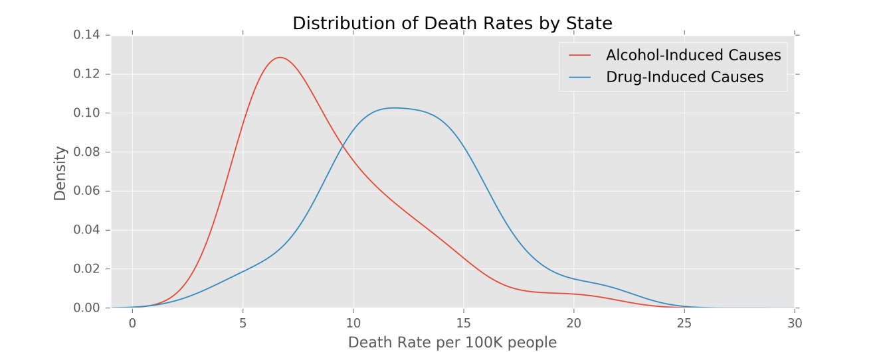
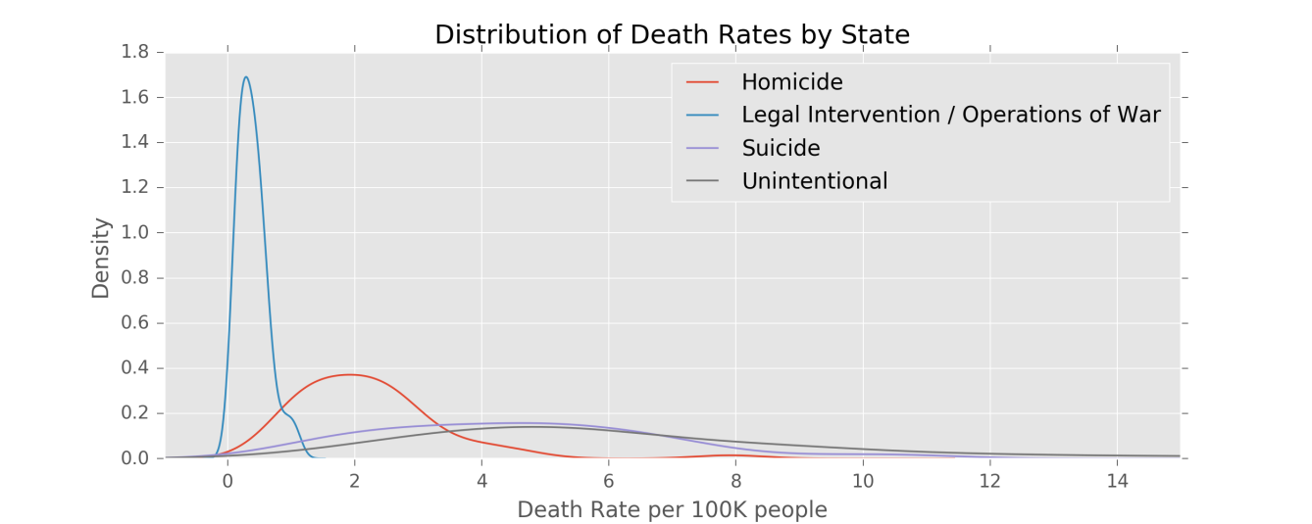
State by State Distributions
Significant range of death rates across america....some states much better then others

Slide 4
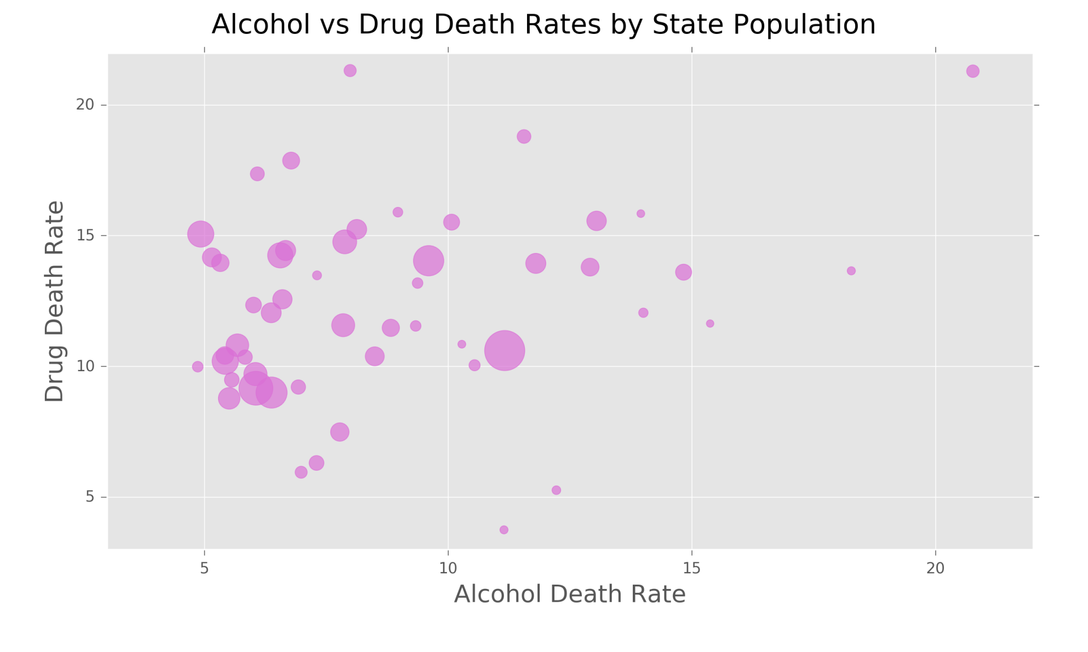
Comparing Drugs & Alcohol
Many states have a 2x – 3x higher rate of drug related deaths compared to alcohol

Slide 5
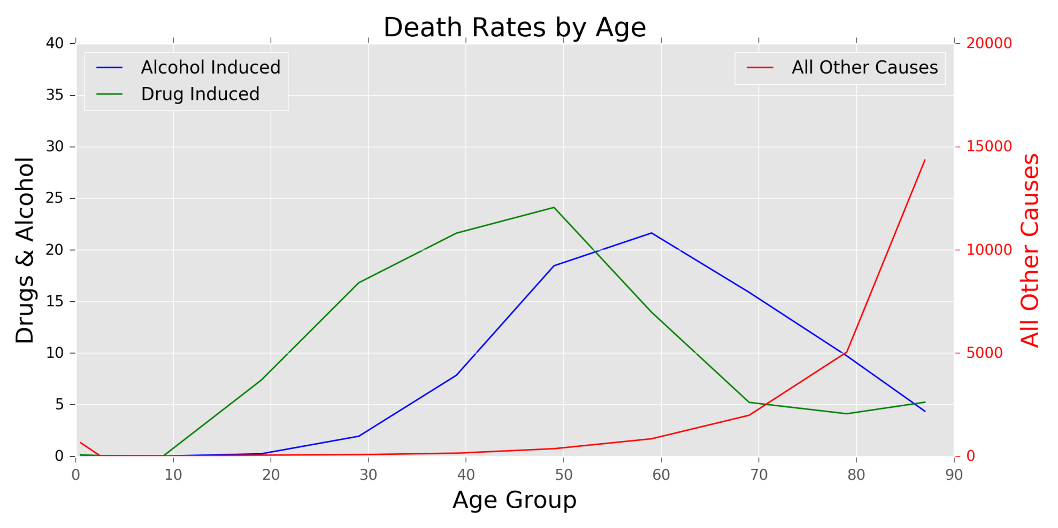
Age Effect with Drugs & Alcohol
People take 10 years longer to kill themselves with alcohol compared to drugs
Drug & Alcohol age effect has very different profile then all other causes of death suggesting they are anything but natural

Slide 6
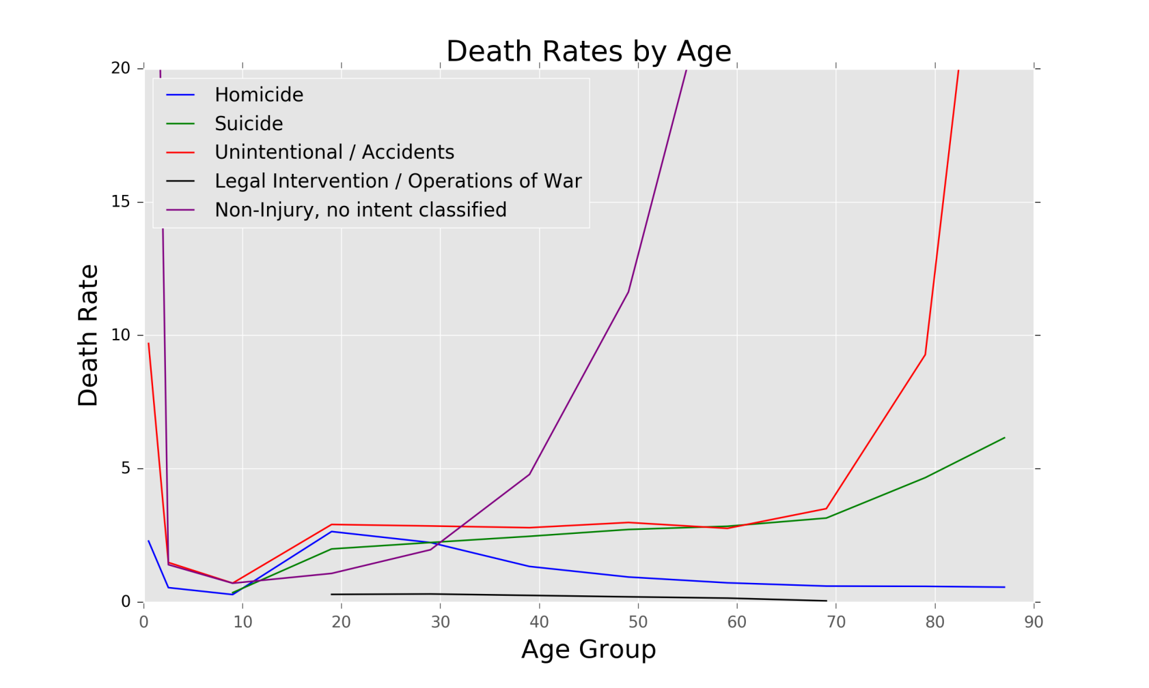
Age Effect for Other Intentional Deaths
Homicides peak at age 20-30 and then decline
Suicides start to climb as teenagers and keep climbing
Accidents are flat from 20-70 and then go way up.
Infant accidents are as high as 80 year old accidents

Slide 7
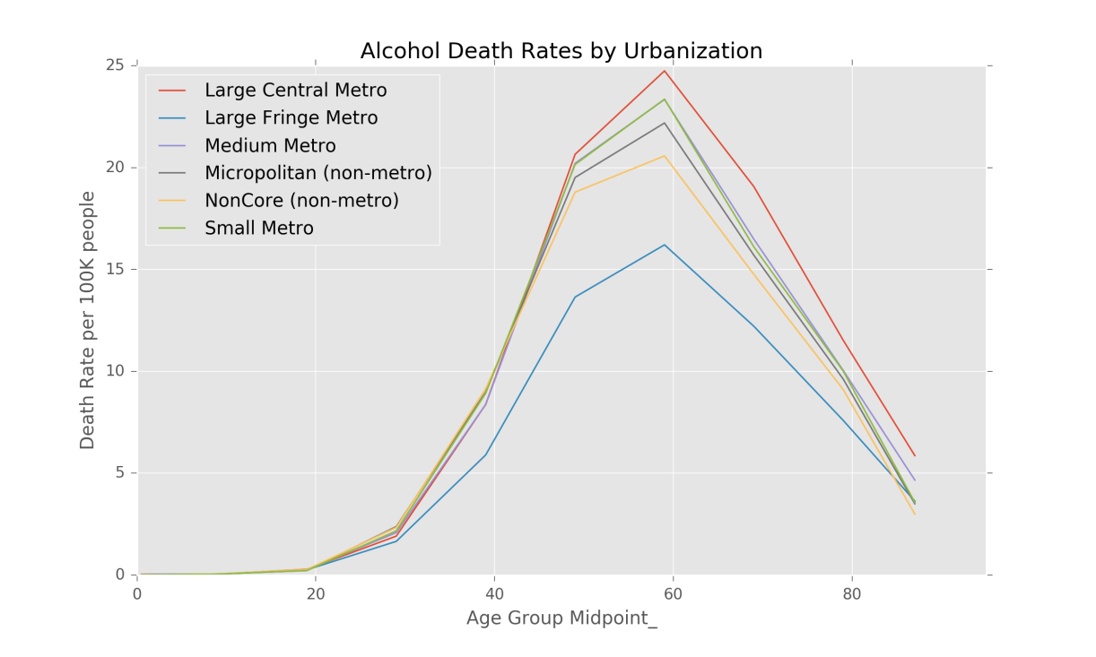
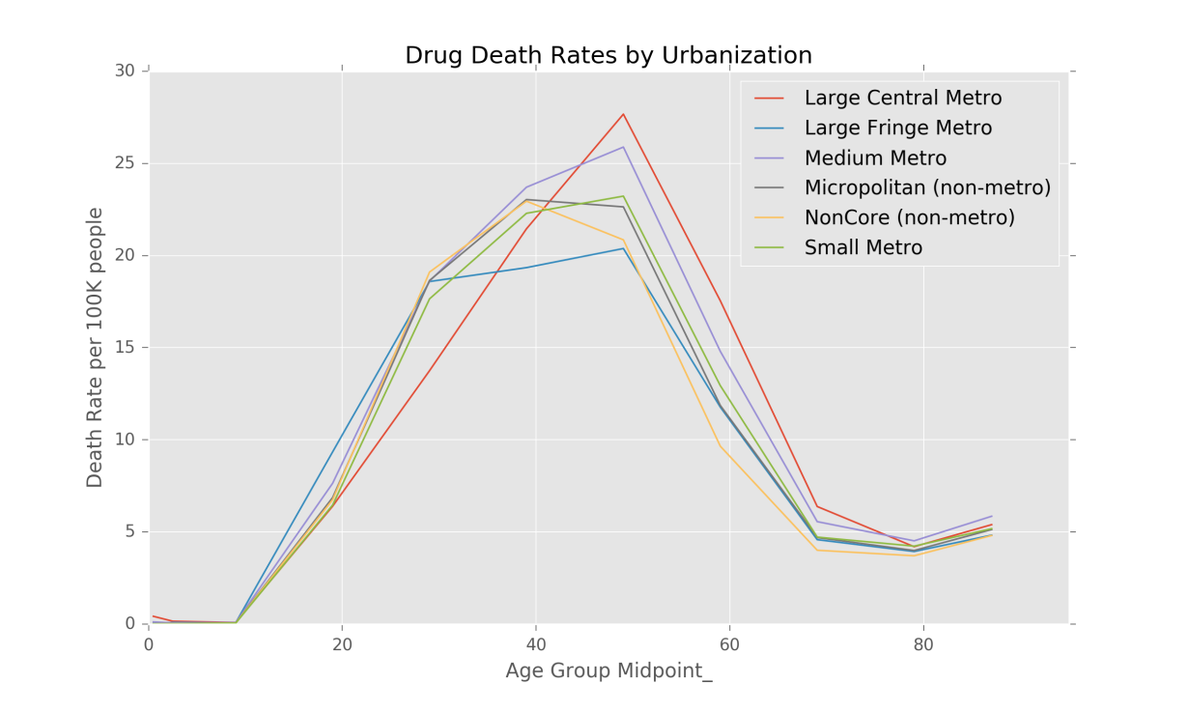
Urbanization Effect
All urbanizations follow the same general pattern by age
Metro rates are worse with large cental metro being the worst
Suburb rates (large fringe metro) are the best
Rural rates (micro & non-metro) are in the middle

Slide 8
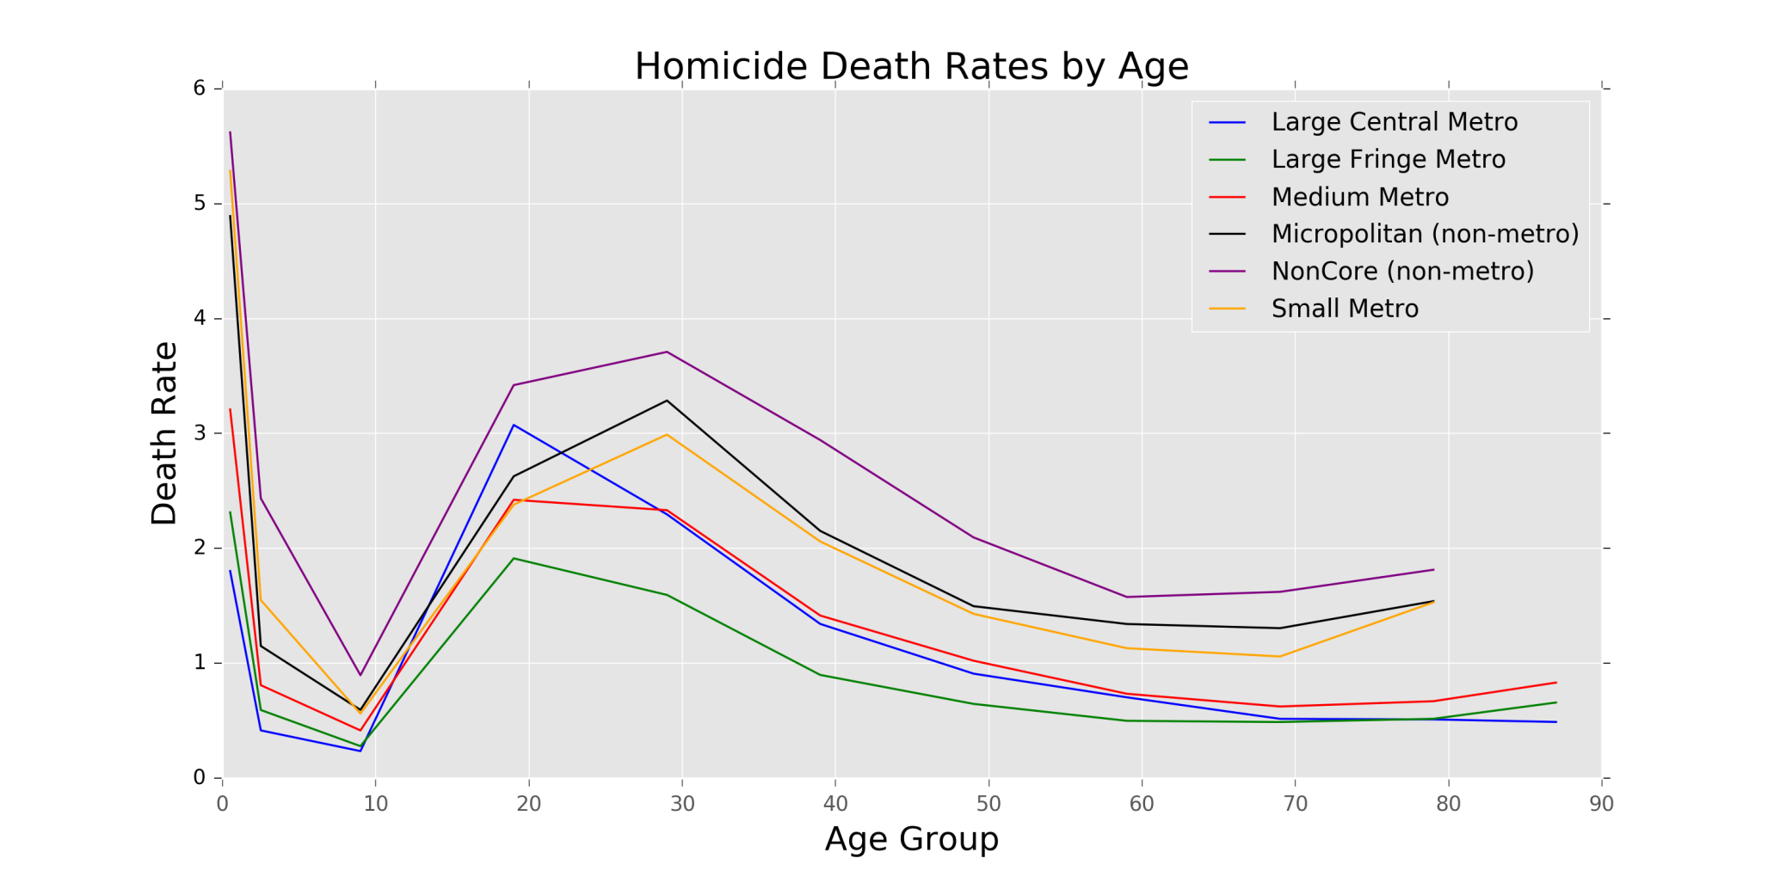
Homicide Urbanization Effect
Metro vs Rural effect is opposite of Drugs & Alcohol
Suburbs (Large Fringe Metro) still the best

Slide 9
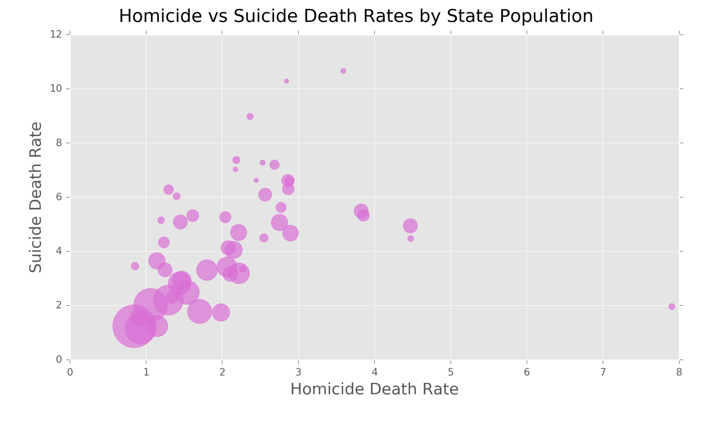
Homicide Urbanization Effect
Some general correlation between Homicide & Suicide for many states
Seems rates get worse as populations get smaller
20% of the states have significantly higher suicide rates then homicide rates

Slide 10
Next Steps
Assemble data from a range of sources that may be able to explain or predict the wide range of death rates.
money, health, crime, climate, education, law enforcement, politics.....
Build & refine a model. Rank the strongest predictors.
Make suggestions for further investigation into root causes and possible solutions.

